Slide 1
RocksDB Festival
Supported by IITP, StarLab.
July 19, 2021
송인호, 한예진
inhoinno@dankook.ac.kr , hbb97225@naver.com
__TeamName__

Slide 2
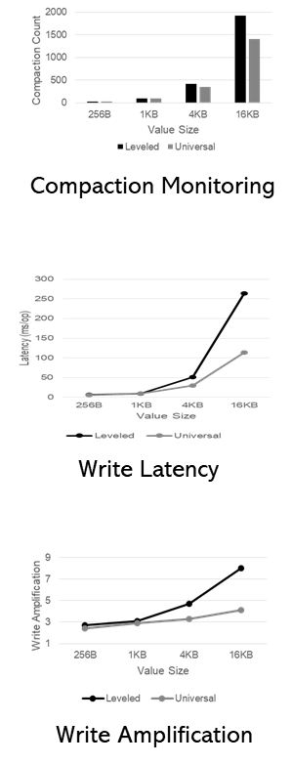
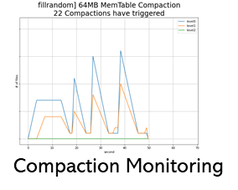
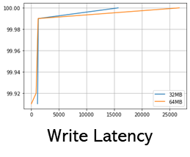
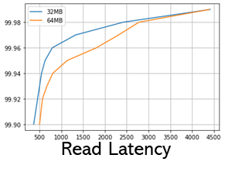
Contents
팀 소개
Compaction
Final Goal!
Quantitative Analysis on RocksDB Compaction
Quantitative Analysis Final Goal
Leveled Compaction vs Universal Compaction
Key-Value size
MemTable size
Next Week
2

Slide 3
Team profile
팀 소개 Compaction
송인호 32152332
한예진 32164881
Final Goal
2021 KSC 반도체학술대회 논문

Slide 4
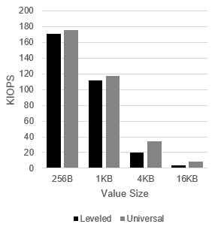

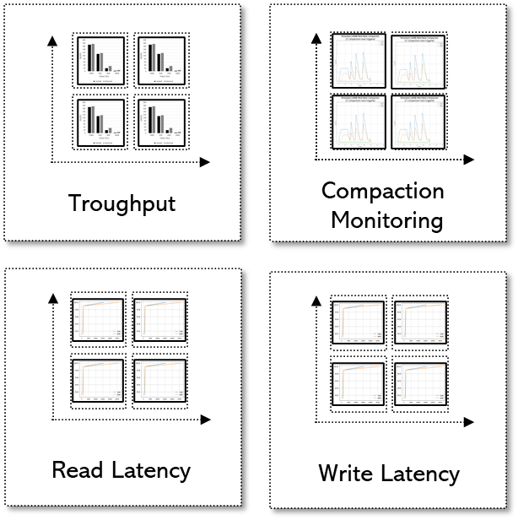
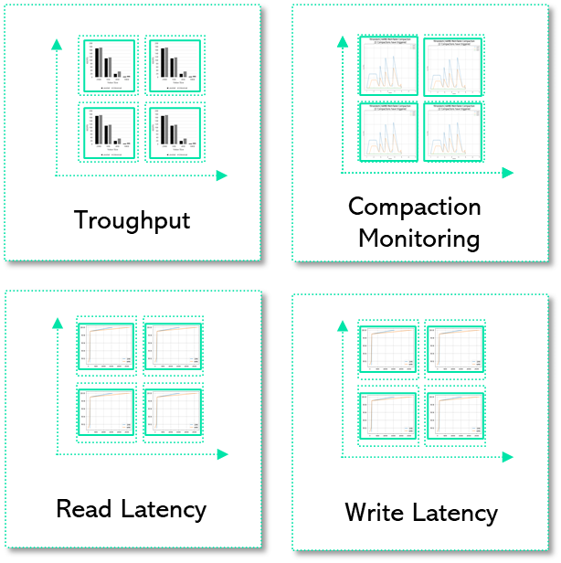



Quantitative Analysis on RocksDB Compaction
Quantitative Analysis on RocksDB Compaction (2week)
Final Goal
Leveled vs
Universal
+BoLT
+Wicskey(blobDB)
+PebblesDB
…
Troughput
Compaction
Monitoring
Read Latency
Write Latency
Value Size
Key Size
SSTable Size
L0 file num
MemTable Size
Scale-Out
Troughput
Read Latency
Compaction
Monitoring
Write Latency

Slide 5
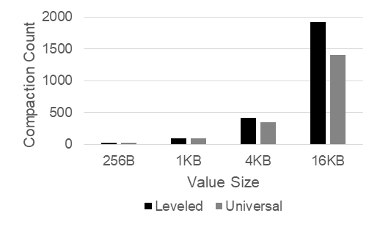
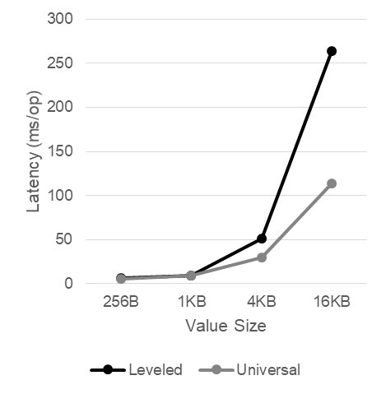
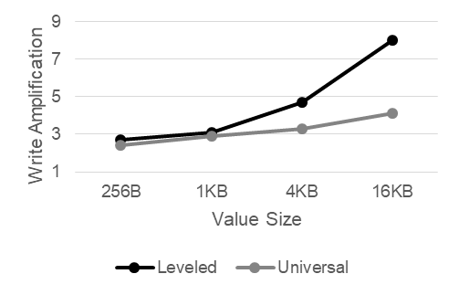
Compaction에 영향을 미치는 녀석들
#1 KV-Size
Various Key Size
Key: 16B, 64B, 256B, 1K
Value: 8K
fillrandom, readrandom, 5000000
Leveled Compaction vs. Universal Compaction
Write Amplification
Various Value Size
Key: 16B
Value: 256B, 1KB, 4KB, 16KB
fillrandom, readrandom, 5000000
Leveled Compaction vs. Universal Compaction
Write Amplification
Compaction Monitoring
Write Latency
Write Amplification

Slide 6
RocksDB Festival
RocksDB::Compaction
Trial#3 Compaction on various Key size (random write)
Throughput
Compaction
Higher is better!
Lower is better!
Latency
WAF
Lower is better!
Lower is better!
6

Slide 7
RocksDB Festival
RocksDB::Compaction
Trial#4 Compaction on various Value size (random write)
Throughput
Compaction
Latency
WAF
7

Slide 8
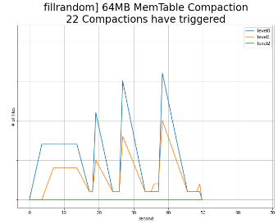
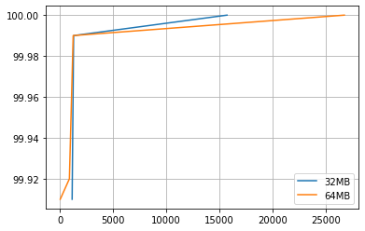
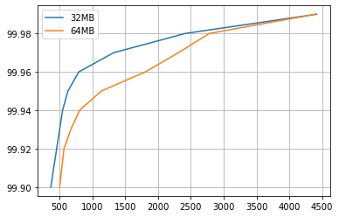
Compaction에 영향을 미치는 녀석들
#2 MemTable, SSTable
Various MemTable + Various SST
64MB, 32MB
fillrandom, readrandom, 16-512, 10000000
Various MemTable + 64MB SST
64MB, 32MB, 16MB, 8MB, 4MB, 2MB
fillrandom, readrandom, 16-512, 10000000
Compaction Monitoring
Write Latency
Read Latency

Slide 9
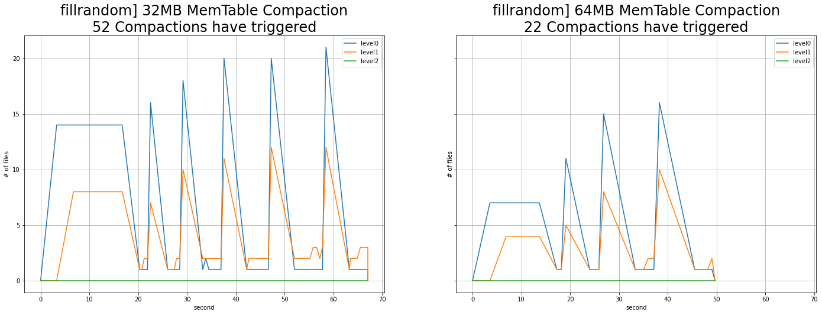
RocksDB Festival
Compaction::SSTable
Trial#1 Compaction on MemTable size&Target File Size (32MB vs 64MB)
☞
9

Slide 10
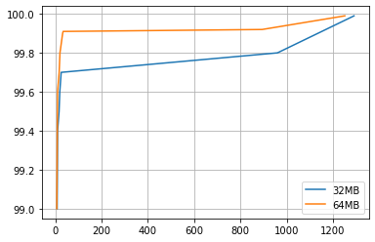
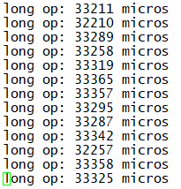
RocksDB Festival
Compaction::SSTable
Trial#1 Compaction on MemTable size&Target File Size (32MB vs 64MB)
fillrandom] Write Latency (99%)
readrandom] Read Latency (99%)
☞ Read/Write latency Trade-off on MemTable Size
10

Slide 11
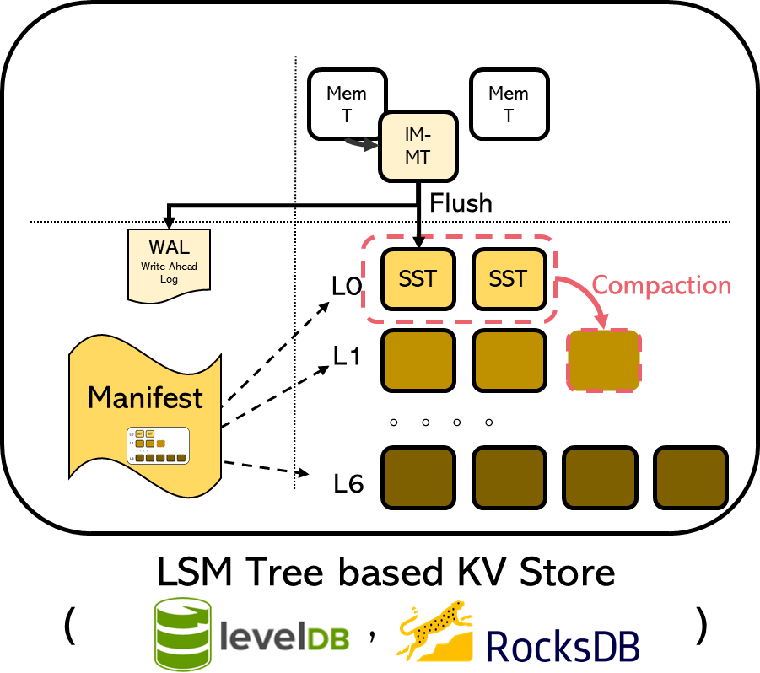
RocksDB Festival
Compaction::SSTable
Trial#2 Compaction on MemTable size, but Target File Size 64MB (MemT=[2,4,8,16,32,64]MB, SST_Level1 = 64MB)
Mem
Table
L0
SST
2MB
~
64MB
L1
SST
64MB
☞
11

Slide 12
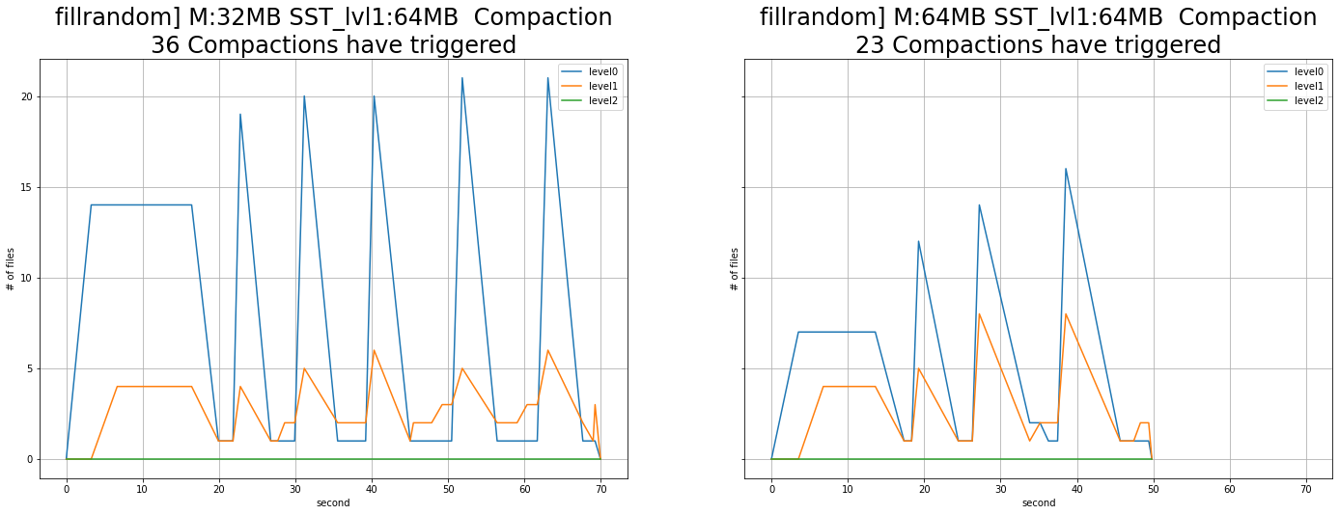
RocksDB Festival
Compaction::SSTable
Trial#2 Compaction on MemTable size, but Target File Size 64MB (MemT=[2,4,8,16,32,64]MB, SST_Level1 = 64MB)
☞ No difference between previous experiment
12

Slide 13
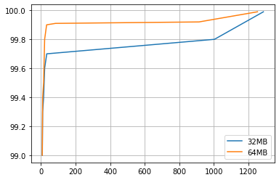
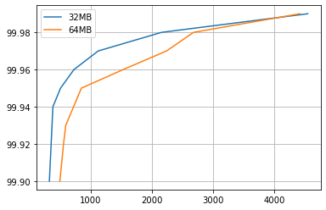
RocksDB Festival
Compaction::SSTable
Trial#2 Compaction on MemTable size&Target File Size (32MB vs 64MB)
fillrandom] Write Latency (99%)
readrandom] Read Latency (99%)
☞ No difference between previous experiment
13

Slide 14
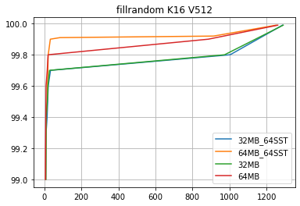
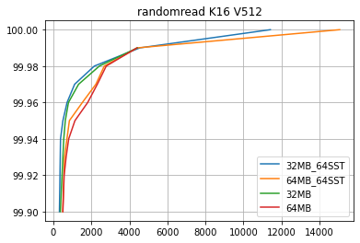

RocksDB Festival
Compaction::SSTable
Trial#1 vs Trial#2
fillrandom] Write Latency (99%)
readrandom] Read Latency (99%)
☞ ..?
14

Slide 15
Compaction에 영향을 미치는 녀석들
#1 KV-Size
Various Key Size
Key: 16B, 32B, 64B, 128B
Value: 8K
fillrandom, readrandom, range query, 5000000
Leveled Compaction vs. Universal Compaction
Write Amplification
Various Value Size
Key: 16B
Value: 256B, 1KB, 4KB, 16KB
fillrandom, readrandom, range query, 5000000
Leveled Compaction vs. Universal Compaction
Write Amplification
---------------Next Week---------------------
+팀원간 measurement 공유
+YCSB Workload, compare Read/Space Amplification
Compaction Monitoring
Write Latency
Write Amplification

Slide 16
Compaction에 영향을 미치는 녀석들
#2 MemTable, SSTable
Various MemTable + Various SST
64MB, 32MB
fillrandom, readrandom, 16-512, 10000000
Various MemTable + 64MB SST
64MB, 32MB, 16MB, 8MB, 4MB, 2MB
fillrandom, readrandom, 16-512, 10000000
---------------Next Week---------------------
+팀원간 measurement 공유
[NEW] level0_file_num_compaction_trigger
-1, 4, 8, 16
fillrandom, readrandom, 16-512, 10000000
YCSB Workload
+YCSB Workload, apply different KV Size
Compaction Monitoring
Write Latency
Read Latency

Slide 17

Discussion

